Slide 1
Academic Writing Process
Md. Mojibur Rahman
mrahmanelt@iitism.ac.in

Slide 2
The academic writing process is like sketching a portrait
You need preparation and planning for what you will draw.
You sketch, and then erase and change what you’ve drawn, and then show it to others.
As you continue to work, you grow as a sketch artist.
The academic writing process is the same.
You prewrite, write, revise, edit, and create a final draft for others to read.
Then you advance your academic writing knowledge and skills.

Slide 3
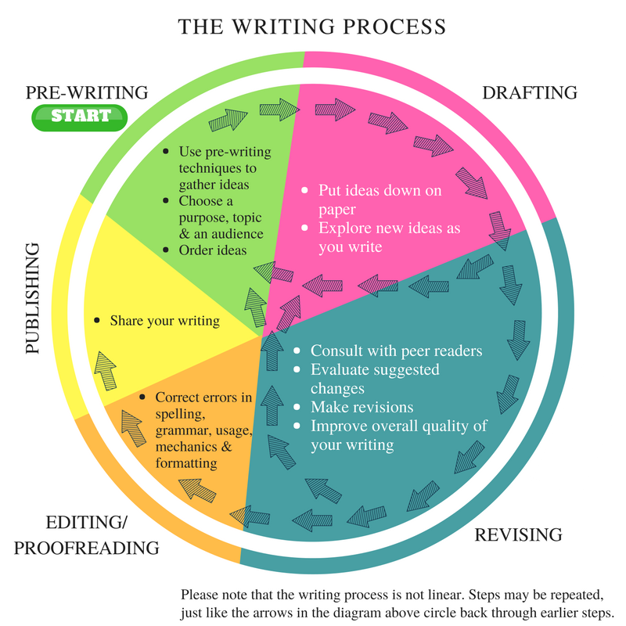

Slide 4
Prewriting: the First Step in the Writing Process
Prewriting is the first step in the writing process and includes any work a writer does before producing a formatted document. In other words, if the end goal is a five-paragraph essay, prewriting is every step that comes before actually writing five paragraphs. Prewriting is sometimes called the planning stage. Prewriting activities include:
Topic selection
Research
Brainstorming
Thesis development
Organization

Slide 5
Topic Selection
A topic may be assigned by a teacher or selected by a writer.
The writer should consider both the audience and the goal of their writing.
When choosing a topic, a writer must also identify the writing they will produce, such as narrative, persuasive, or expository.

Slide 6
Research
Some types of writing require gathering information from various sources.
Writers should choose current, reliable, valid sources and keep track of which information came from which source.

Slide 7
Brainstorming
Brainstorming is a gathering of ideas. There are many ways to brainstorm, including:
Freewriting: On a blank piece of paper, write everything that comes to mind on the chosen topic. Write continuously for several minutes. When finished, go through the freewriting and highlight words, phrases, and sentences useful in the writing.

Slide 8

Graphic organizers: Graphic organizers come in almost limitless varieties. They have in common a visual way to write and connect words, phrases, and ideas. A graphic organizer might look like a spider web, with circled words connected by lines, or it might look like a flowchart showing which ideas come first, second, third, etc.
Graphic organizers are one tool that can be used for brainstorming. Brainstorming is part of prewriting, the first step of the writing process.

Slide 9
Lists: Simple lists of items that need to be included in a text can be an effective means of brainstorming.
Pictures: Drawing pictures of text elements can be a way to organize thoughts during the brainstorming stage.

Slide 10
Thesis Development
A thesis is a concise statement of the central idea or argument of the text.
The thesis, presented as part of the introduction, informs the reader of what the author intends to accomplish in the text.
A writer should experiment with several versions of a thesis statement, then choose the one that best fits the text.

Slide 11
Organization
It is essential to take the ideas and information gathered during the prewriting process and organize it into a logical format.
Organization often takes the form of an outline, but it could also be a story map, a series of pictures, or a list.
While organizing, consider how the information can be ordered to best support the thesis statement.

Slide 12
Drafting: the Second Step in the Writing Process
Drafting is the next phase of the writing process.
The first draft is the first time the prewriting ideas, goals, and information are written in the paper's intended format, including complete sentences and paragraphs.
A first draft should follow the outline or other organizational plan developed during prewriting and should include the major components of the paper, such as introduction, body, and conclusion.

Slide 13
It is important to note that mechanics should not be the focus of the first draft, and the first draft does not need to be good.
Once ideas are on the page, they can be revised, rearranged, and edited as necessary.
Careful writers should not skip the drafting process.
Many papers go through several drafts before being completed.
The goal of a first draft is to put sentences and paragraphs on the page.

Slide 14
Write sentences and paragraphs even if they are not perfect.
Create a thesis statement with your main idea.
Put the information you researched into your essay accurately without plagiarizing. Remember to include both in-text citations and a bibliographic page.
Read what you have written and judge if it says what you mean. Write some more.
Read it again.
Write some more.
Read it again.
Write until you have said everything you want to say about the topic.

Slide 15
Revising: the Third Step in the Writing Process
Revision is the key to effective documents.
Here you think more deeply about your readers’ needs and expectations. The document becomes reader-centered.
How much support will each idea need to convince your readers?
Which terms should be defined for these particular readers?
Is your organization effective?
Do readers need to know X before they can understand Y?
At this stage you also refine your prose, making each sentence as concise and accurate as possible. Make connections between ideas explicit and clear.

Slide 16
There are 2 types of revision:
self- revision
peer/teacher/coach revision.
When you revise, read your writing, and analyze the content. Ask yourself:
Does everything is your essay or paper connect to your thesis? Does it prove it? Is it off-topic?
Do you have enough content to support your thesis? If not, find more evidence.
Does the organization of your essay or paper make sense?
Do you have an engaging introduction that sets up your essay, research paper, etc.? Is your conclusion powerful?

Slide 17
Read what you have written again. Rearrange words, sentences, or paragraphs into a clear and logical order.
Take out or add parts.
Do more research if you think you should.
Replace overused or unclear words.
Read your writing aloud to be sure it flows smoothly. Add transitions.

Slide 18
When you have another person help you revise, ask them to read your work and give you feedback on the content, organization, clarity, and things they like and suggestions about what to improve.
The difference between revising and editing writing is that revising focuses on changing the content and organization of what you write. Editing is where you fix mistakes: grammar, spelling, omitted words, punctuation, vocabulary, citations, and references, etc.

Slide 19
Editing and Proofreading
Editing is where you fine-tune your essay, research paper, or another project. It is looking at the small details that make your writing grammatically correct and easy to understand.
Editing a piece of academic writing involves the same things as other pieces of writing: sentence mechanics and variety, grammar, punctuation, and spelling. It also includes looking for omitted words or wording that is confusing, or vocabulary that doesn’t make sense.
What makes editing academic writing different is that you need to look for mistakes with citations, references, and any charts and graphs that you include. You’ll want to make sure that you are following the correct reference system for your subject (MLA, APA, Chicago Style, Turabian, etc.).

Slide 20
Be sure all sentences are complete.
Correct spelling, capitalization, and punctuation.
Change words that are not used correctly or are unclear.
Make sure you are using the appropriate style formatting.
  APA Formatting
  Chicago Style Formatting
  MLA Formatting
Have someone else check your work.

Slide 21
Publishing
Publishing is the last phase of the academic writing process.
It’s where you take your piece of writing and share it with others (your classmates, colleagues, professors, online or in a book or journal).
What is essential about publishing is you’re sharing your ideas and knowledge with an audience.
You have the chance to change what people think, how they act, and open their eyes to things they never knew before.
You are making your mark on the world through your writing.

